Slide 1
IF I WERE SATAN’S MINISTER
“So the great dragon was cast out, that serpent of old, called the Devil and Satan, who deceives the whole world…” (Rev. 12:9)
And the dragon was enraged with the woman, and he went to make war with the rest of her offspring, who keep the commandments of God…” (Rev. 12:17)

Slide 2
2 Corinthians 2:11
“lest Satan should take advantage of us; for we are not ignorant of his devices.”

Slide 3
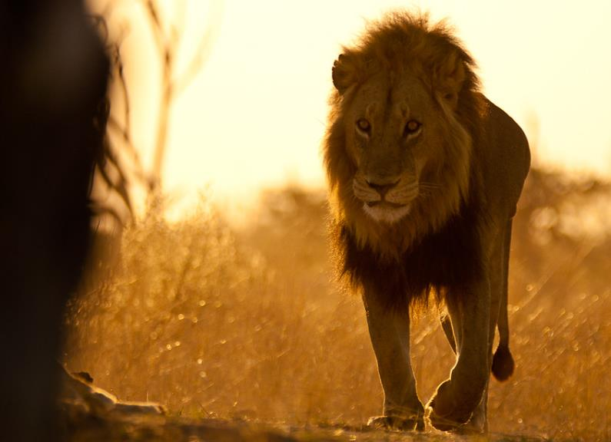
“Be sober, be vigilant; because your adversary the devil walks about like a roaring lion, seeking whom he may devour”

Slide 4
Satan’s
¹³ For such are false apostles, deceitful workers, transforming themselves into apostles of Christ.
¹⁴ And no wonder! For Satan himself transforms himself into an angel of light.”
(2 Cor. 11)
All following verses are NKJV unless otherwise noted

Slide 5
Satan’s Minister
¹⁵ Therefore it is no great thing if his ministers also transform themselves into ministers of righteousness, whose end will be according to their works” (2 Cor. 11)
All following verses are NKJV unless otherwise noted

Slide 6
If I were Satan’s Minister…
“All preachers are good, godly, and trustworthy.”
I would teach that a person like me doesn’t exist.

Slide 7
TRANSFORM
ministers of righteousness
wolves in sheep’s clothing
thornbushes
thistles
WAIT!
“Beware of false prophets, who come to you in sheep’s clothing, but inwardly they are ravenous wolves. You will know them by their fruits. Do men gather grapes from thornbushes or figs from thistles?” (Matt. 7:15, 16)

Slide 8
“Now I urge you, brethren, note those who cause divisions and offenses, contrary to the doctrine which you learned, and avoid them” (Rom. 16:17)

Slide 9
“But there were also false prophets among the people, even as there will be false teachers among you, who will secretly bring in destructive heresies, even denying the Lord who bought them, and bring on themselves swift destruction. ² And many will follow their destructive ways, because of whom the way of truth will be blasphemed” (2 Pet. 2:1-2)

Slide 10
Questions:
If all preachers are good, why are these passages in the Bible?
If the devil doesn’t have any ministers, what are these passages saying?

Slide 11
Any Qualifications for an Apostle?
eye-witness of resurrection (Acts 1:20-22)
chosen by the Lord (Acts 1:24)
PAUL
The Last To See the Raised Christ
“Then LAST OF ALL He was seen by me also, as by one BORN OUT OF DUE TIME” (1 Cor. 15:8)

Slide 12
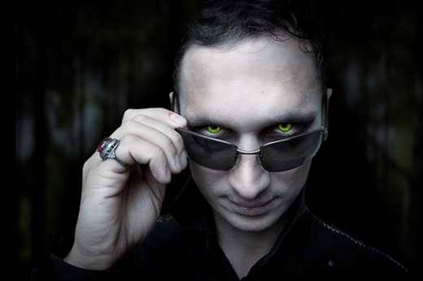
If I were Satan’s Minister…
“Trust me. I am the PASTOR of this church!”
I would teach that you should embrace the one-man-pastor system and not question him.

Slide 13
Bible pastors were elders
Elders (Acts 20:17)
Are to pastor/shepherd (Acts 20:28)
Elders (in the plural) governed as a unit (eldership) over one church
Acts 14:23; 1 Tim. 4:14
A one-man-pastor system was never authorized by Christ

Slide 14
“Test all things” (1 Thess. 5:21)
1 John 4:1, “Beloved, do not believe every spirit, but test the spirits, whether they are of God; because many false prophets have gone out into the world.”
Proverbs 14:15, “The simple believes every word, But the prudent considers well his steps.”
Ephesians 5:10, “Finding out what is acceptable to the Lord.”

Slide 15
